Slide 1
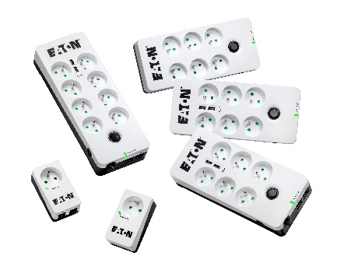
Eaton Protection Box
High-end surge protection for residential and professional critical equipment
© Eaton 2018 Tous droits réservés

Slide 2
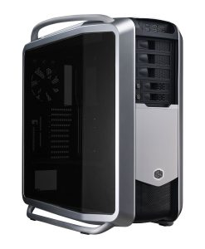
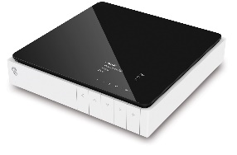
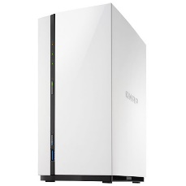
Typical applications
High-end surge protection for critical equipment
Industrial
NAS
Multimedia
Computers
Internet gateways
Industrial
Indu
Industrial
© Eaton corporation 2018. Tous droits réservés

Slide 3
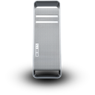
Value proposition
Differentiation Points |  | Why It Matters?
High-end surge protection Surge protection circuit complies to IEC 61643-11 surge standard |  | Insures user peace of mind as critical equipment are really protected against lightning thanks to our certified technology
Dual protection Both power and xDSL line are protected |  | Provides a full protection whatever the surge origin
Mobile charging capability Integrates USB charging ports |  | All power sockets are available for critical user equipment. Mobile device charging is insured by the integrated USB ports.
© Eaton corporation 2018. Tous droits réservés

Slide 4
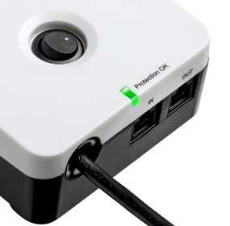
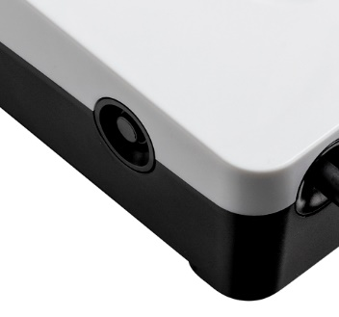
Peace of mind
Power line protection
High-end surge protection complying to IEC 61643-11 standard
xDSL line protection
High-end surge protection complying to IEC 61643-21 standard
Overload protection
10A circuit breaker
© Eaton corporation 2018. Tous droits réservés

Slide 5
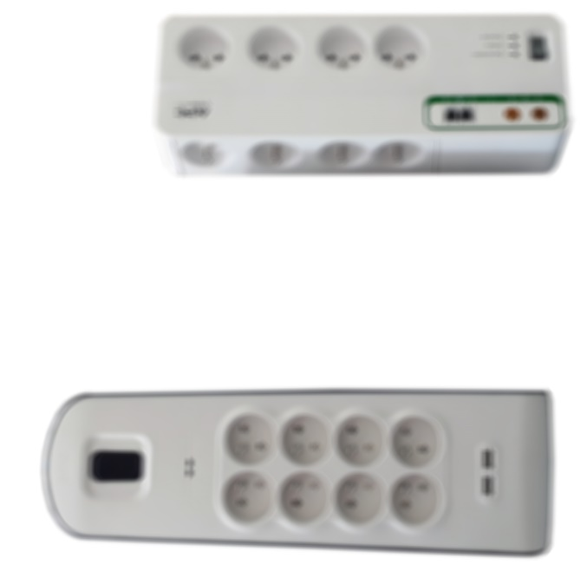
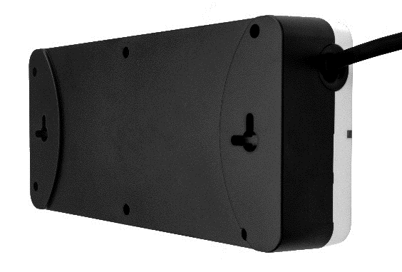
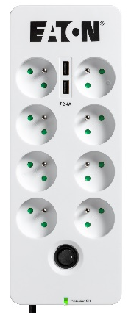
Integration
Compact design
Easier to integrate vs competition
Wall mounting
Available for 6 and 8 outlet models
© Eaton corporation 2018. Tous droits réservés

Slide 6
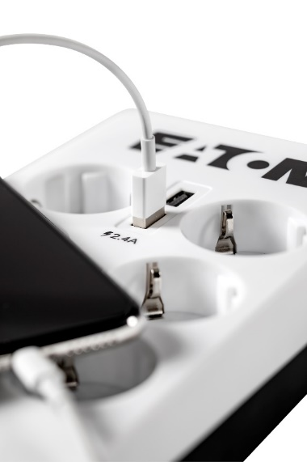
Easy to use
Local outlets
Available in FR or DIN formats
USB charging ports
Two convenient built-in USB ports
2.4A (total) for quick charging
No more need to use mobile device chargers
© Eaton corporation 2018. Tous droits réservés

Slide 7
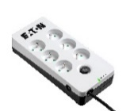
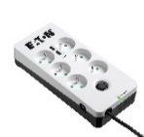
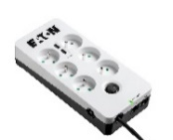
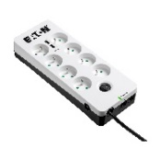
Range overview
 | PB1 | PB1 Tel@ | PB6 | PB6 USB | PB6 USB Tel@ | PB8 USB Tel@
Power line protection compliant to IEC 61643-11
Tel@ line protection
USB charge
Connected equipment warranty | 12000€ | 12000€ | 25000€ | 25000€ | 25000€ | 50000€
© Eaton corporation 2018. Tous droits réservés

Slide 8
Conversion table
New Protection Box range ➔ Legacy Protection Box range
New Protection Box range | Ref | Legacy Protection Box range | Ref
Eaton Protection Box 1 FR | PB1F | Eaton Protection Box 1 FR | 66706
Eaton Protection Box 1 DIN | PB1D | Eaton Protection Box 1 DIN | 66708
Eaton Protection Box 1 Tel@ FR | PB1TF | Eaton Protection Box 1 Tel@ FR | 66707
Eaton Protection Box 1 Tel@ DIN | PB1TD | Eaton Protection Box 1 Tel@ DIN | 66709
Eaton Protection Box 6 FR | PB6F | Eaton Protection Box 5 FR | 66710
Eaton Protection Box 6 FR | PB6F | Eaton Protection Box 5 FR-B | 66932
Eaton Protection Box 6 DIN | PB6D | Eaton Protection Box 5 DIN | 66712
Eaton Protection Box 6 USB FR | PB6UF
Eaton Protection Box 6 USB DIN | PB6UD
Eaton Protection Box 6 Tel@ USB FR | PB6TUF | Eaton Protection Box 5 Tel@ FR | 66711
 |  | Eaton Protection Box 5 Tel@+TV FR | 66934
 |  | Eaton Protection Box 5 Tel@+TV FR-B | 66938
Eaton Protection Box 6 Tel@ USB DIN | PB6TUD | Eaton Protection Box 5 Tel@ DIN | 66713
 |  | Eaton Protection Box 5 Tel@+TV DIN | 66936
Eaton Protection Box 8 Tel@ USB FR | PB8TUF | Eaton Protection Box 8 Tel@+TV FR | 66935
Eaton Protection Box 8 Tel@ USB DIN | PB8TUD | Eaton Protection Box 8 Tel@+TV DIN | 66937
© Eaton corporation 2018. Tous droits réservés

Slide 9
Conversion table
Legacy Protection Box range➔ New Protection Box range
Legacy Protection Box range | Ref | New Protection Box range | Ref
Eaton Protection Box 1 FR | 66706 | Eaton Protection Box 1 FR | PB1F
Eaton Protection Box 1 DIN | 66708 | Eaton Protection Box 1 DIN | PB1D
Eaton Protection Box 1 Tel@ FR | 66707 | Eaton Protection Box 1 Tel@ FR | PB1TF
Eaton Protection Box 1 Tel@ DIN | 66709 | Eaton Protection Box 1 Tel@ DIN | PB1TD
Eaton Protection Box 5 FR | 66710 | Eaton Protection Box 6 FR | PB6F
Eaton Protection Box 5 FR-B | 66932 | Eaton Protection Box 6 FR | PB6F
Eaton Protection Box 5 DIN | 66712 | Eaton Protection Box 6 DIN | PB6D
 |  | Eaton Protection Box 6 USB FR | PB6UF
 |  | Eaton Protection Box 6 USB DIN | PB6UD
Eaton Protection Box 5 Tel@ FR | 66711 | Eaton Protection Box 6 Tel@ USB FR | PB6TUF
Eaton Protection Box 5 Tel@+TV FR | 66934
Eaton Protection Box 5 Tel@+TV FR-B | 66938
Eaton Protection Box 5 Tel@ DIN | 66713 | Eaton Protection Box 6 Tel@ USB DIN | PB6TUD
Eaton Protection Box 5 Tel@+TV DIN | 66936
Eaton Protection Box 8 Tel@+TV FR | 66935 | Eaton Protection Box 8 Tel@ USB FR | PB8TUF
Eaton Protection Box 8 Tel@+TV DIN | 66937 | Eaton Protection Box 8 Tel@ USB DIN | PB8TUD
© Eaton corporation 2018. Tous droits réservés

Slide 10
Eaton.com/whatmatters

